Slide 1
Dr. Anil Chhangani
Associate Professor
9821382455
Use Blue ray protector glasses

Slide 2
Frequency Reuse
Frequency Reuse is the scheme in which allocation and reuse of channels throughout a coverage region is done
Each cellular base station is allocated a group of radio channels or Frequency sub-bands to be used within a small geographic area known as a cell
The shape of the cell is Hexagonal
The process of selecting and allocating the frequency sub-bands for all of the cellular base station within a system is called Frequency reuse or Frequency Planning.

Slide 3
Frequency Reuse
Salient features of using Frequency Reuse:
It improves the spectral efficiency and signal Quality (QoS)
It is classical scheme proposed for GSM systems offers a protection against interference
The number of times a frequency can be reused is depend on the tolerance capacity of the radio channel from the nearby transmitter that is using the same frequencies
In Frequency Reuse scheme, total bandwidth is divided into different sub-bands that are used by cells
Frequency reuse scheme allow operators to reuse the same frequencies at different cell sites

Slide 4
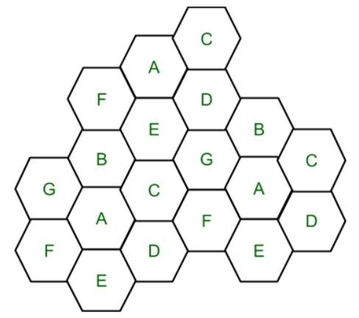
Frequency Reuse
Cell with the same letter uses the same set of channels group or frequencies sub-band
To find the total number of channel allocated to a cell
S = Total number of duplex channels available to use
k = Channels allocated to each cell (k<S)
N = Total number of cells or Cluster Size
Total number of channels (S)
S = kN
Frequency Reuse Factor = 1/N

Slide 5
Frequency Reuse
In the diagram cluster size is 7 (A,B,C,D,E,F,G) thus frequency reuse factor is 1/7
N is the number of cells which collectively use the complete set of available frequencies is called a Cluster
The value of N is calculated by the following formula:
N = I² + I*J + J²
If a Cluster is replicated or repeated M times, then Capacity, C, will be,
C = MkN = MS

Slide 6
Frequency Reuse
In Frequency reuse there are several cells that use the same set of frequencies
These cells are called Co-Channel Cells
These Co-Channel cells results in interference
To avoid the Interference cells that use the same set of channels or frequencies are separated from one another by a larger distance
The distance between any two Co-Channels can be calculated by the following formula:
D = R * (3 * N)^{1/2}
where, R = Radius of a cell N = Number of cells in a given cluster

